Slide 1
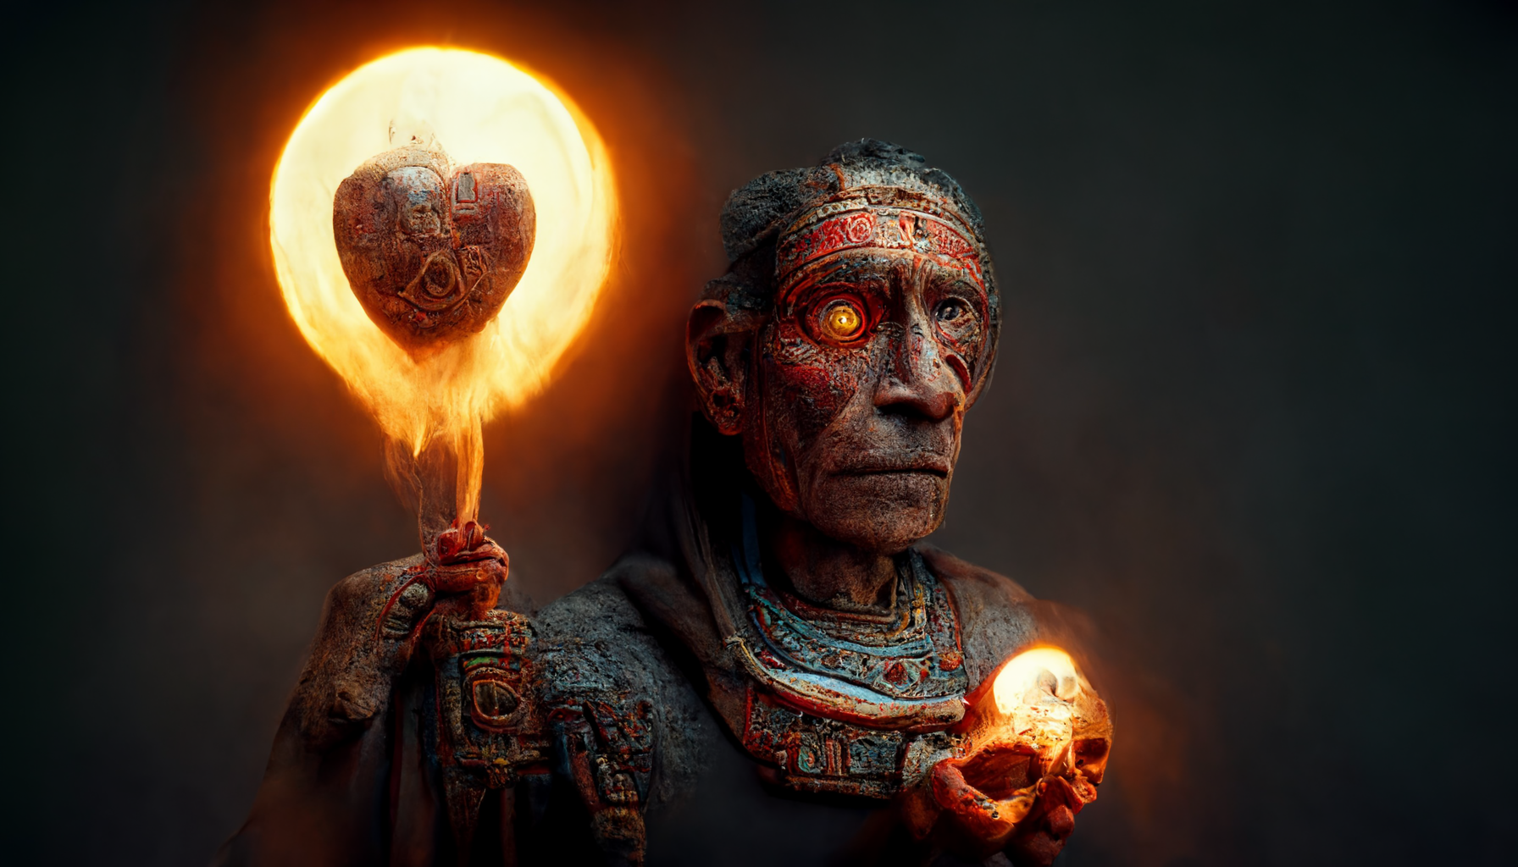

Slide 2
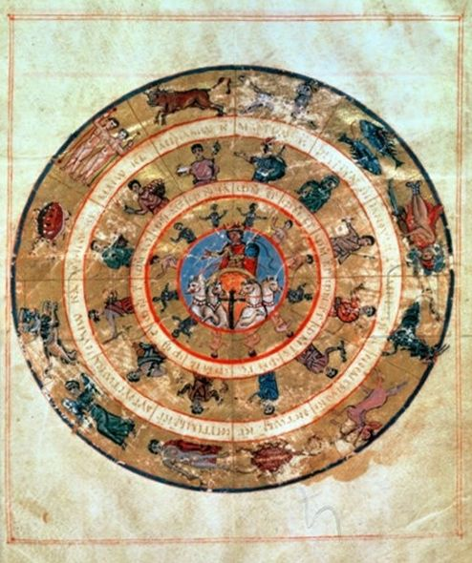
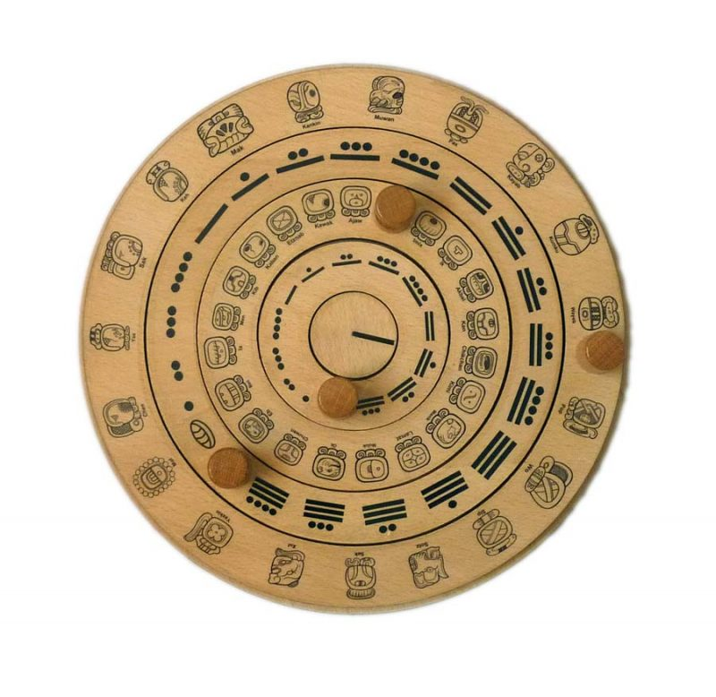
Byzantine Calendar says creation began on Sep 1 5509
Hebrew Calendar says creation began
on Oct 7 3761 BC
Mayan Calendar says creation began
on Aug 11 3114 BC

Slide 3
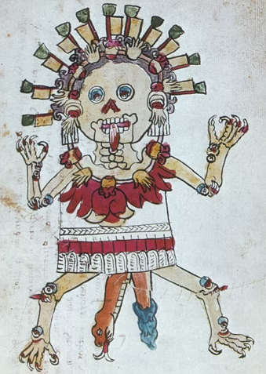
Mesoamerican Androgyne
For the Quiche Maya, the world was created in the beginning by The Begetter, known as “Heart of Sky, Heart of Earth”, a dual-sexed deity whom is both mother and father to all of the world’s inhabitants (Tedlock 1985, 72, 76).
The Aztecs had a similar deity, Ometeotl, the God of Duality, who is both a single entity and a male-female pair, known as Ometeuctli, the Lord of Duality, and his female counterpart, Omecihuatl, the Lady of Duality (Haly 1992, 272); this dual-gendered entity, whose name Ometeotl is translated from Nahuatl to mean “Place of Duality, God of Two”, was the source of all things, the well from which creation springs for all life (Leon-Portilla 1999, 133).
Notes:
Mythology of the Aztec Empire includes the twins of Quetzalcoatl (meaning “Feathered Serpent” in Nahuatl, a language used by the Aztec People of Central Mexico) and Tezcatlipoca (“Smoking Mirror”), in addition to the siblings of Huitzilopochtli (“Hummingbird on the Left”) and Coyolxauhqui (“Face Painted with Bells”)
Ometeotl's sons were the powerful Aztec gods Xipe Totec, Tezcatlipoca, Quetzalcoatl, and Huitzilopochtli.
Xipe-Totec, Tezcatlipoca, Quetzalcoatl, Huitzilopochtli

Slide 4
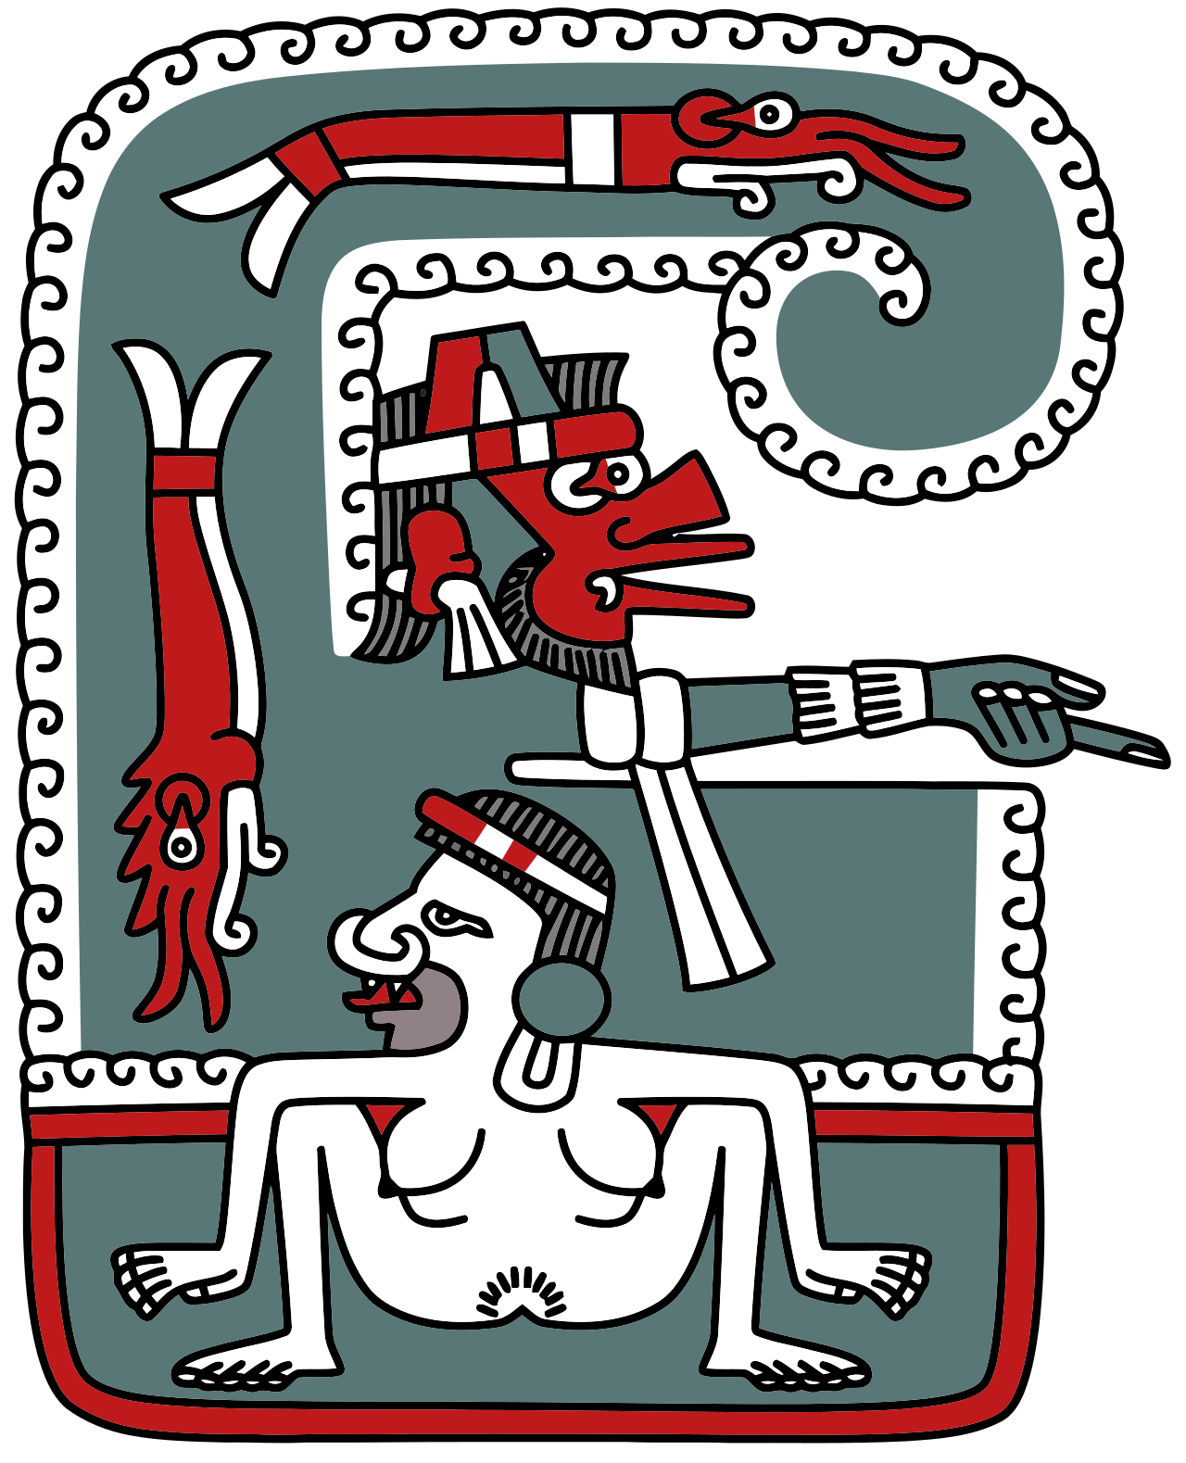
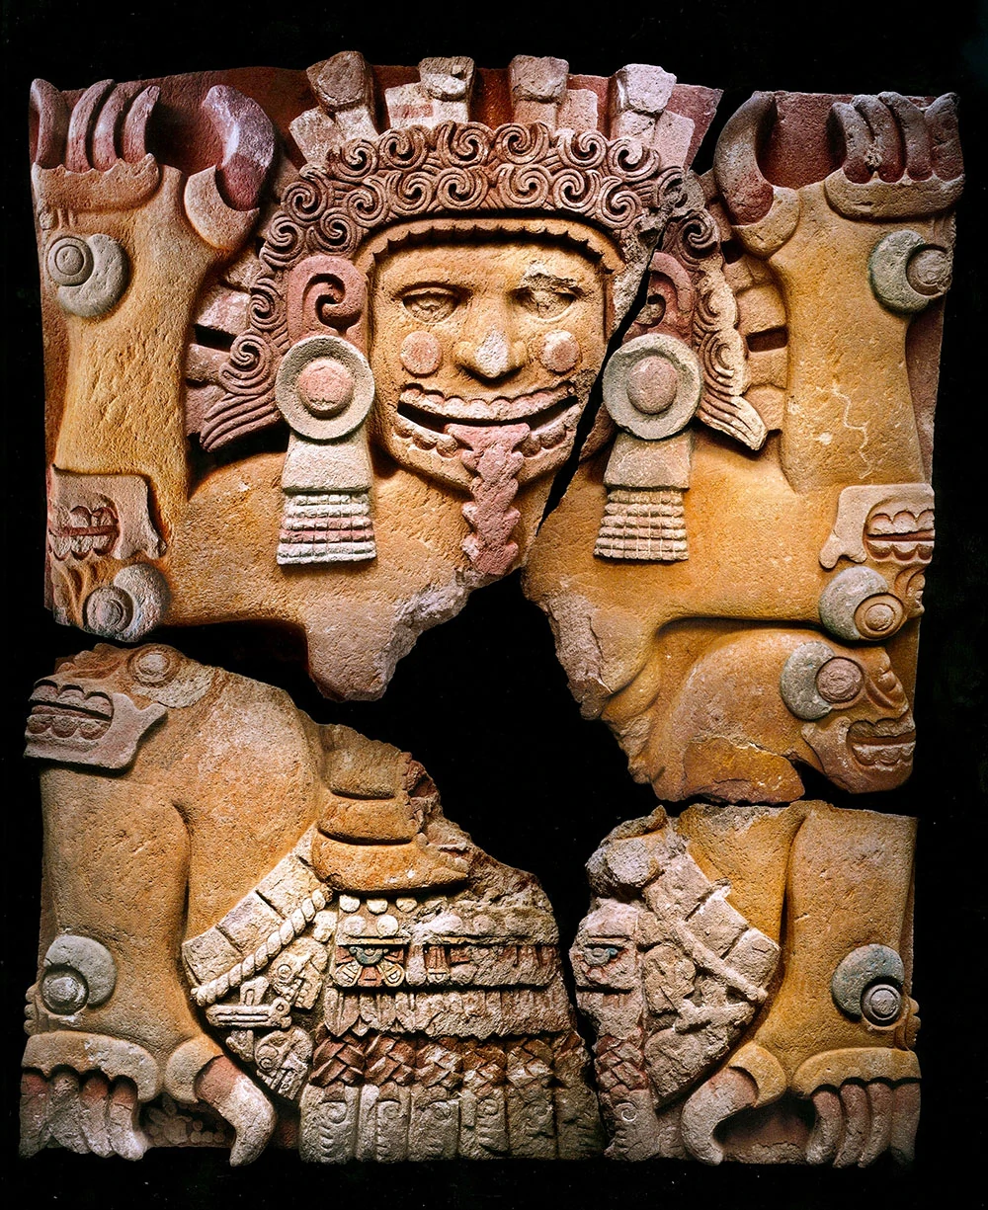
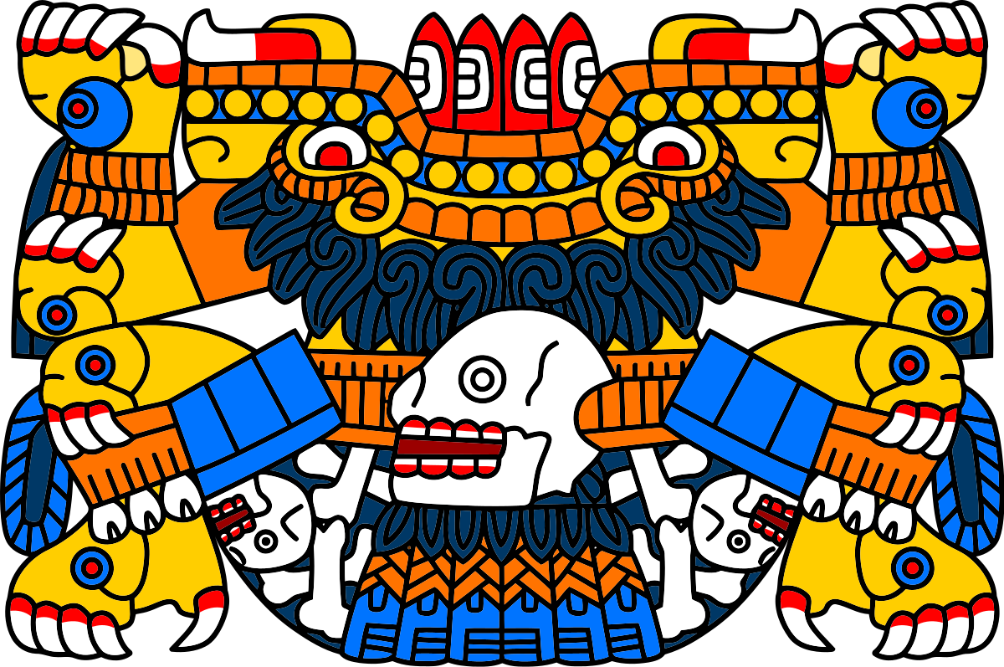
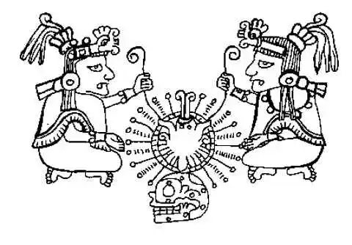
Tlaltecuhtli
Ometéotl
Chimalma
Notes:
Xolotl
In Aztec Myth, Quetzalcoatl is described as having another companion, a twin: Xolotl. These two are seen as the manifestations of the morning and evening Venus star, where Xolotl represents Quetzalcoatl's twin, or shadow, a dark, nighttime aspect of the deity.

Slide 5
Tlaltecuhtli Codex Chimalpopoca
Notes:
With Ilancueye: the giants Xelhua, Tenoch, Ulmecatl, Xicalancatl, Mixtecatl, Otomitl Tlaltecuhtil

Slide 6
Ometéotl
“Two-god” or god of duality
formed by
a feminine
(Omecíhuatl)
and a masculine
(Ometecuhtli)
Twins gave birth to more twins to create the first male and female.
Notes:
Ōme translates as "two" or "dual" and teōtl translates as "god”

Slide 7
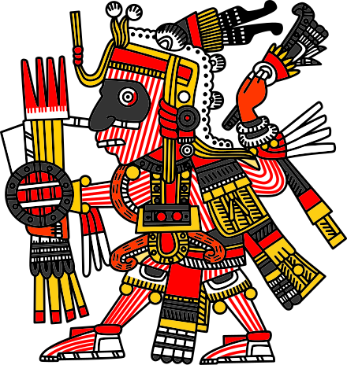
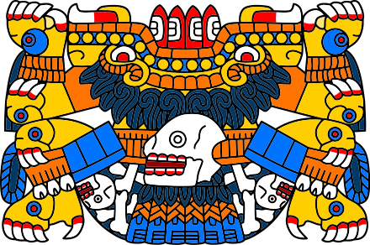
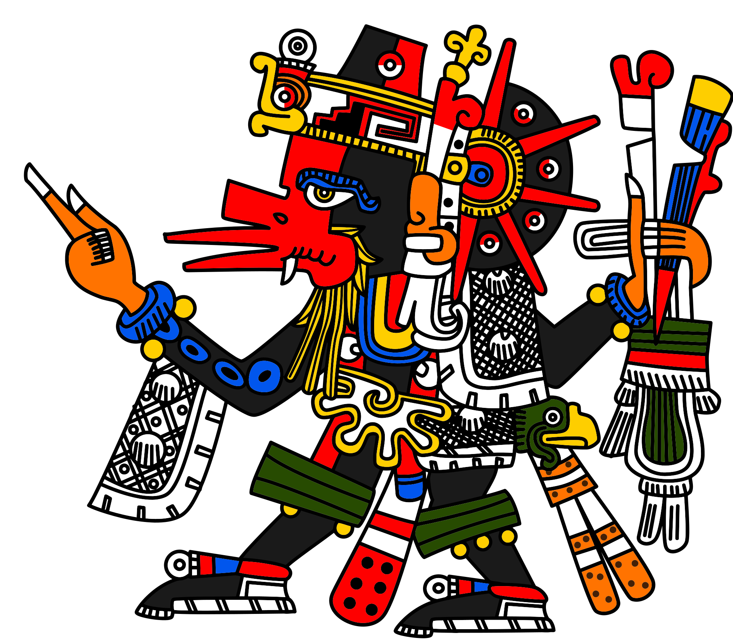
Patricide
Matricide
Kronos dismembered his father
Quetzalcoatl dismembered his mother
Uranus
Gaia
Iztac-
Mixcoatl
Tlaltecuhtli
Kronos
Quetzalcoatl
Notes:
With Ilancueye: the giants Xelhua, Tenoch, Ulmecatl, Xicalancatl, Mixtecatl, Otomitl

Slide 8
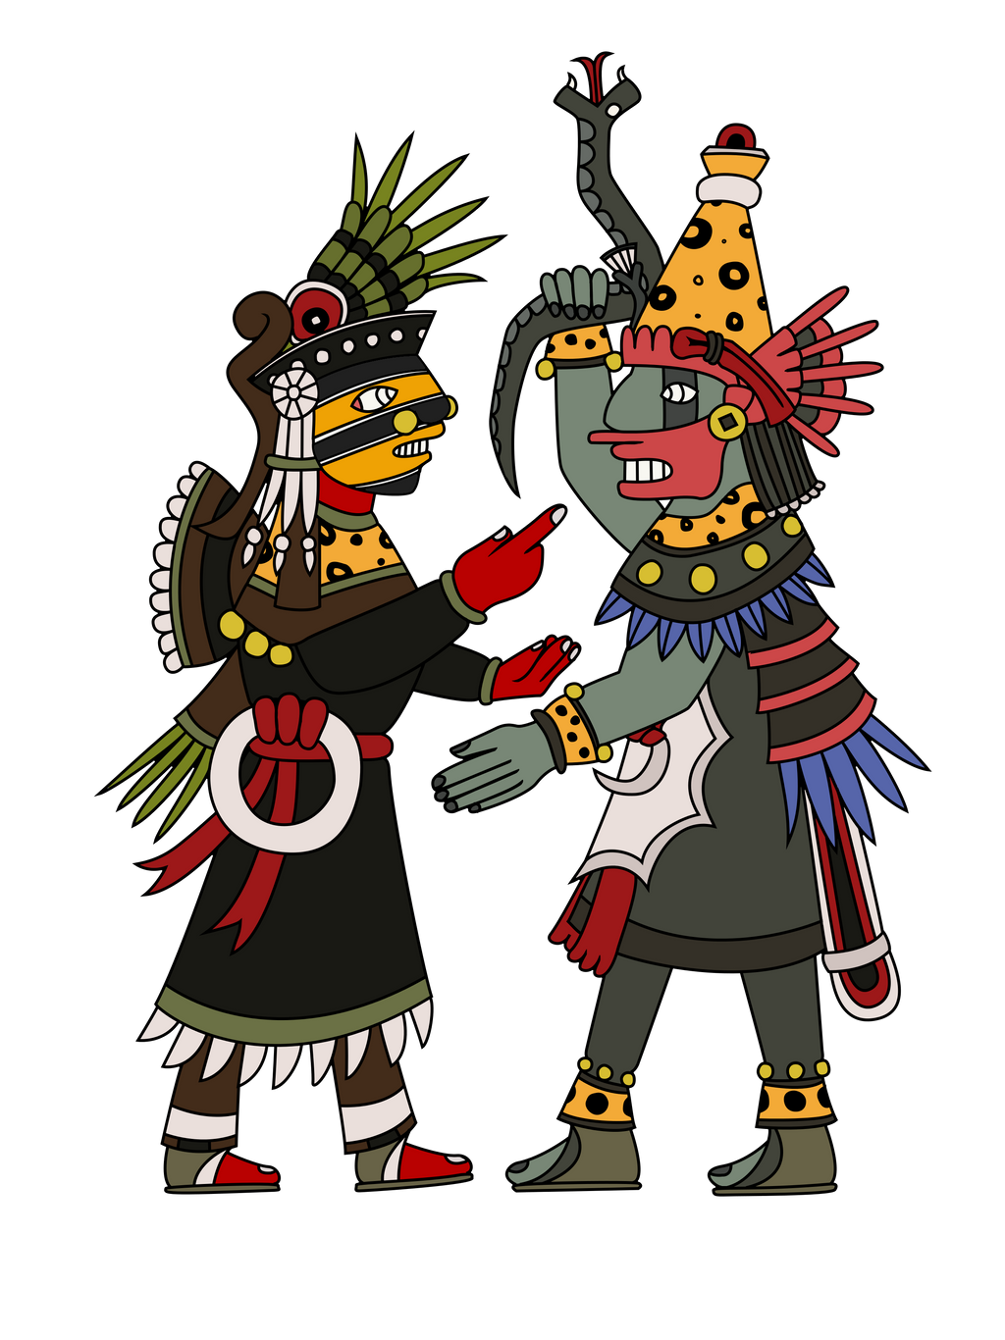
Ometéotl the dual god and her chimera twins
Ōme translates as "two" or "dual" and teōtl translates as "god”
Ometecuhtli, (Nahuatl: “Two-Lord”) Aztec deity, “Lord of the Duality” or Lord of Life, who represented one aspect of the cosmic duality of the Aztec tradition. With his female counterpart, Omecíhuatl (“Two-Lady” or “Lady of the Duality”), Ometecuhtli resided in Omeyocan (“Two-Place” or “Double Heaven”), the 13th and highest Aztec heaven. The opposing factors in the Aztec universe included male and female, light and dark, motion and stillness, and order and chaos.
Huitzilopochtli and Quetzalcoatl were told to create the first male and female humans.
Notes:
Mythology of the Aztec Empire includes the twins of Quetzalcoatl (meaning “Feathered Serpent” in Nahuatl, a language used by the Aztec People of Central Mexico) and Tezcatlipoca (“Smoking Mirror”), in addition to the siblings of Huitzilopochtli (“Hummingbird on the Left”) and Coyolxauhqui (“Face Painted with Bells”)
Ometeotl's sons were the powerful Aztec gods Xipe Totec, Tezcatlipoca, Quetzalcoatl, and Huitzilopochtli.
Xipe-Totec, Tezcatlipoca, Quetzalcoatl, Huitzilopochtli

Slide 9
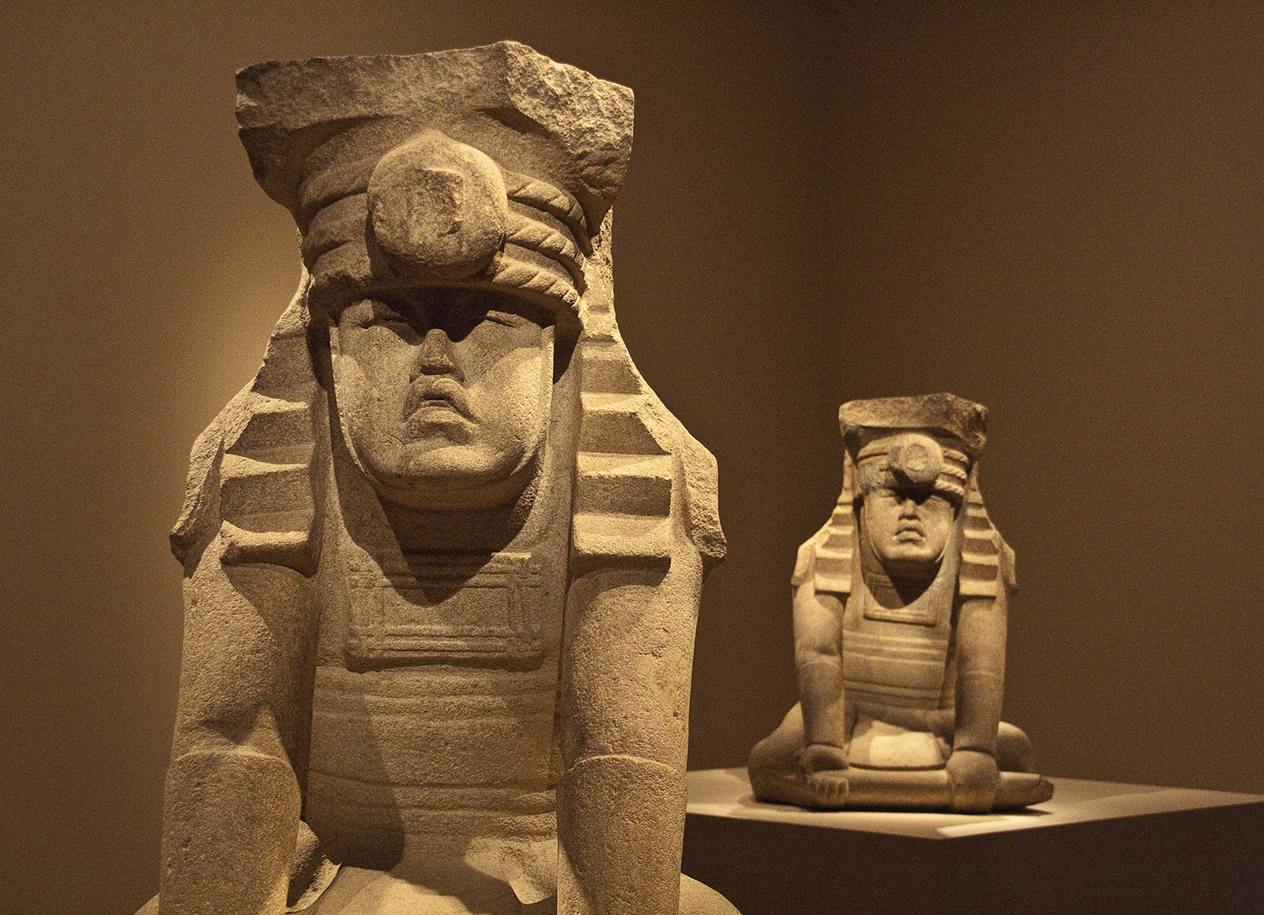
Olmec Twins
El Azuzul
Notes:
Hunahpu and Xbalanque
Who non coo and shibulanque

Slide 10
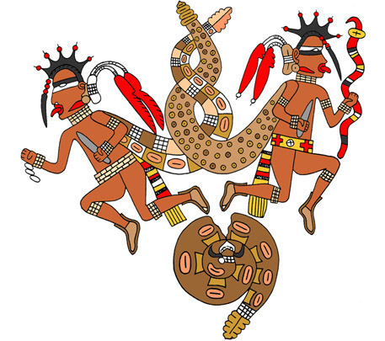
Twins of twins
Hunahpu and Xbalanque
Maya Hero Twins of the Popol Vuh
Whose father and uncle were also twins
Notes:
Hunahpu and Xbalanque
Who non coo and shibulanque

Slide 11
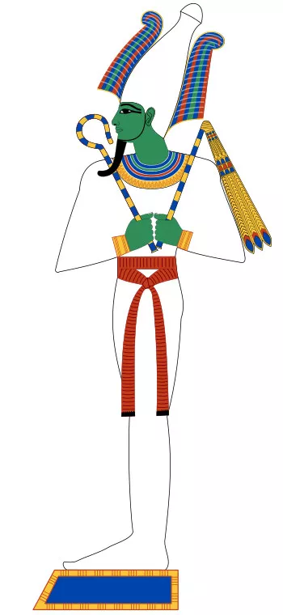
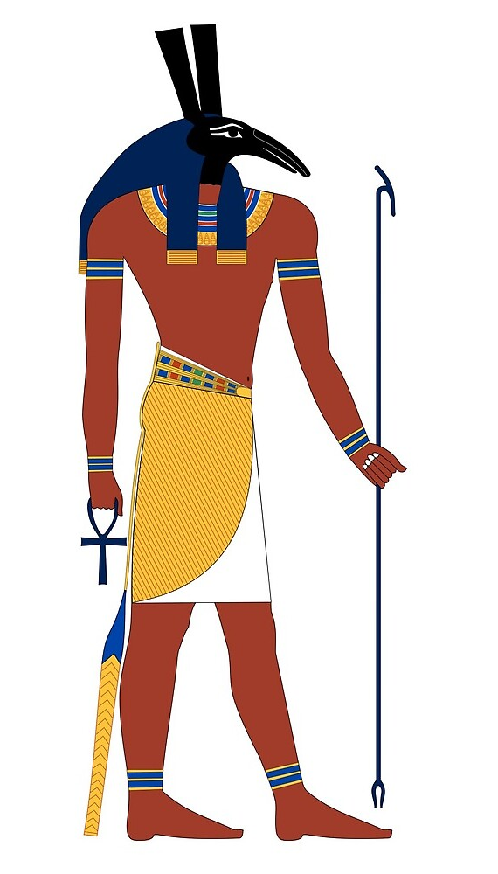
Twins of twins
Osiris and Set
Bringer of light betrayed by brother
Dog
Outshined by brother retaliates
Notes:
Hunahpu and Xbalanque
Who non coo and shibulanque

Slide 12
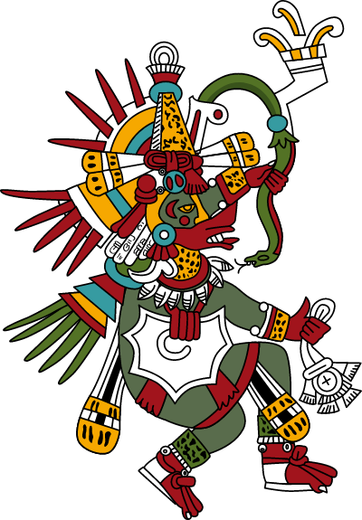
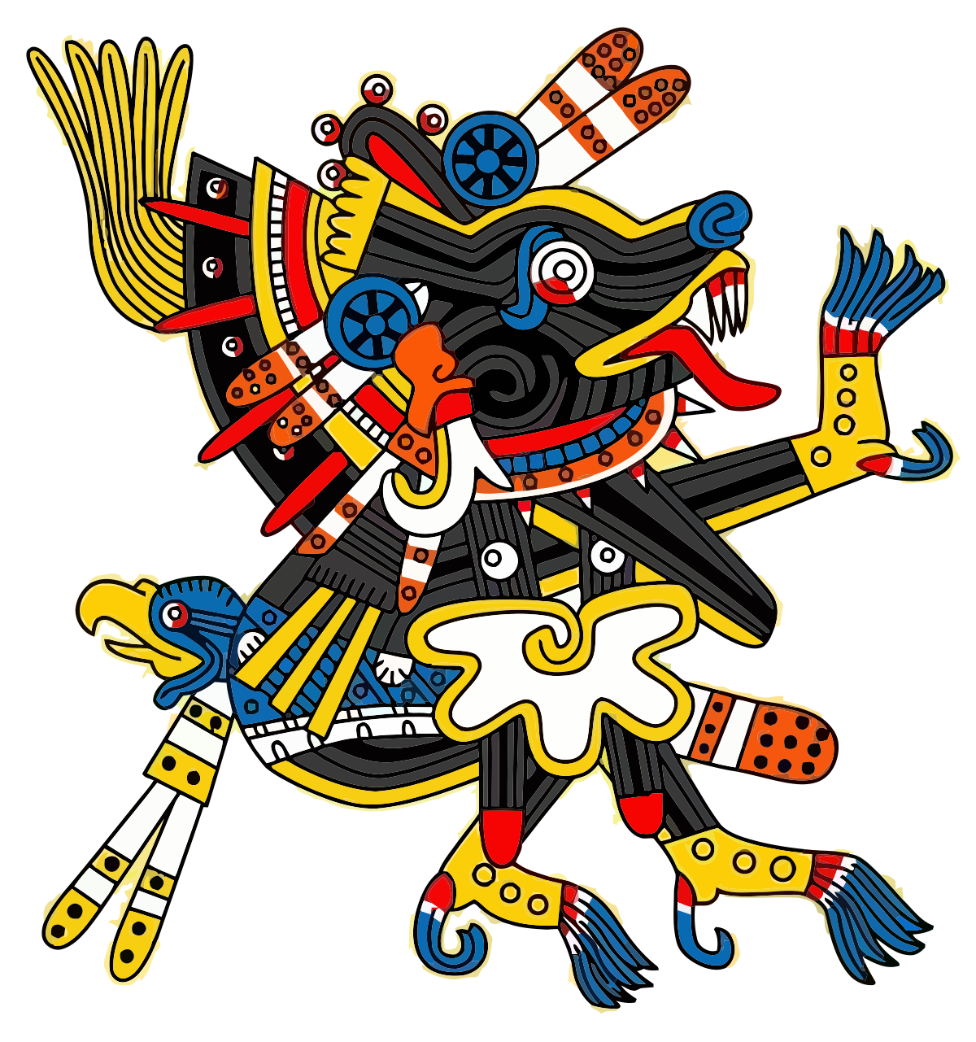
Twins of twins twins
Quetzalcoatl and Xolotl
Morning Star
Luciferus
Evening Star
Noctiferus
Notes:
Hunahpu and Xbalanque
Who non coo and shibulanque

Slide 13
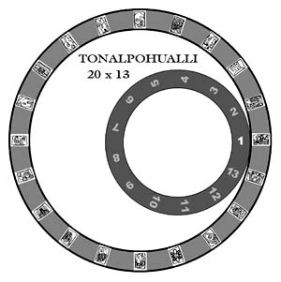
Tonalpohualli
The “counting of the days” This went back to great antiquity in Mesoamerica, perhaps to the Olmec civilization of the 1st millennium BCE. It formed a 260-day cycle. The calendar was broken down into trecenas of 20 days with each day having its own name and symbol.
The number 260 has multiple significances: Human gestation period
The period between the appearance of Venus
The length of the Mesoamerican agricultural cycle.

Slide 14
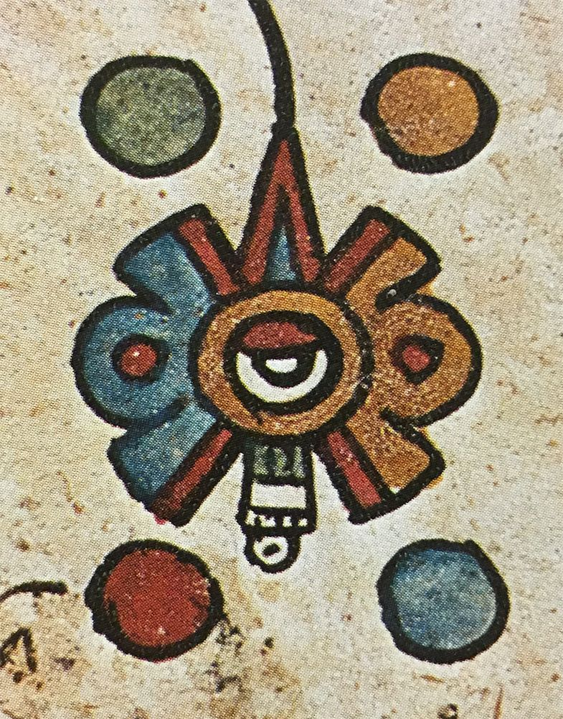
Nahui Ollin
Four movement
Ollin, meaning 'movement', is the day of the Aztec calendar associated with Xolotl. Xolotl is the god of shifting shapes, twins and Venus, the Evening Star.

Slide 15
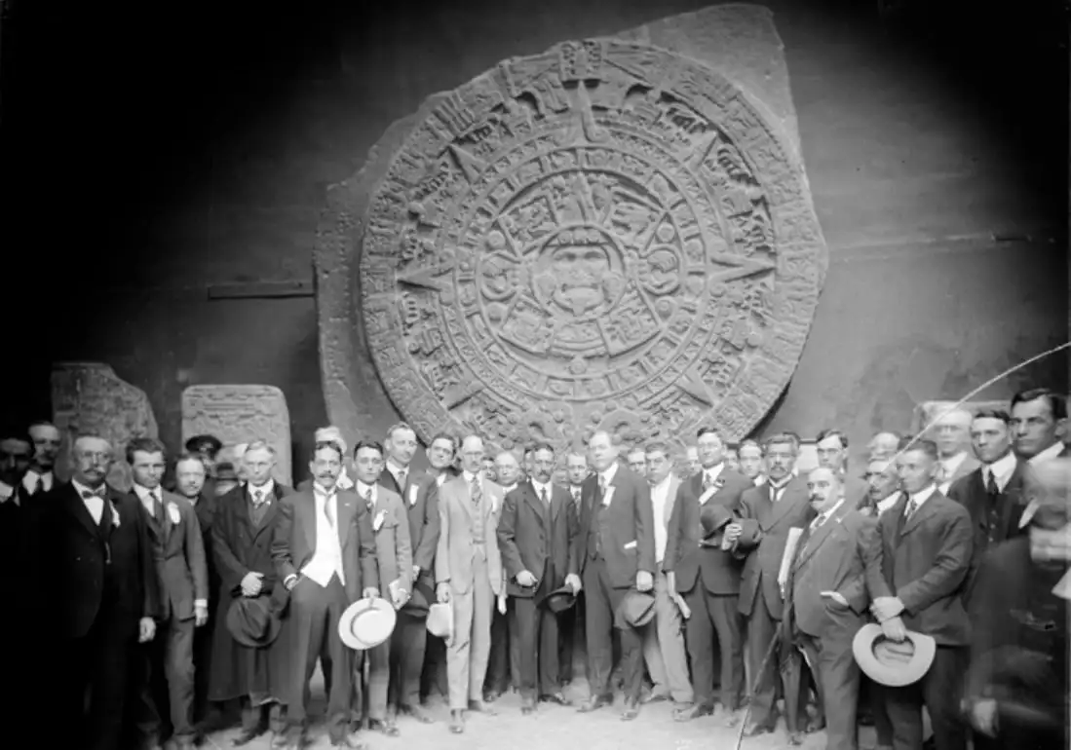
Human Butcher Block or Stone
Day Planner?
Modern archaeologists, such as those at the National Anthropology Museum in Mexico City, believe it is more likely to have been used primarily as a ceremonial basin or ritual altar for gladiatorial sacrifices, than as an astrological or astronomical reference.
Notes:
With Ilancueye: the giants Xelhua, Tenoch, Ulmecatl, Xicalancatl, Mixtecatl, Otomitl

Slide 16
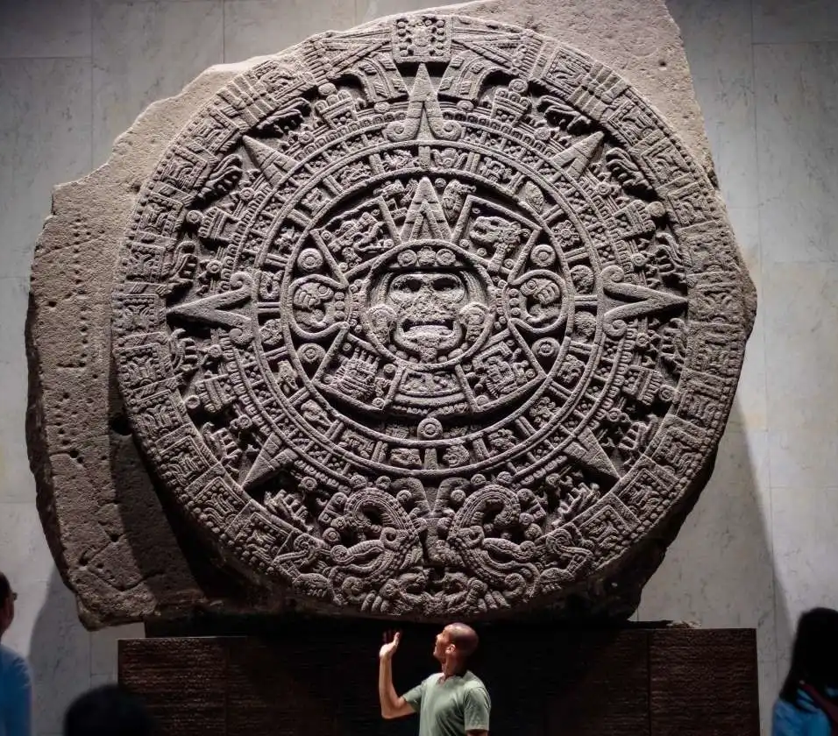
The Stone of Axayacatl
The Aztec Calendar (Sun Stone) was originally named Cuauhxicalli, or Eagle Bowl, in Aztec. It was commissioned by the Aztec ruler, Axayacatl who reigned from 1469-1481 when it was common practice for each new ruler to commission not only a new Sun Stone, but also a renovation of the Templo Mayor.

Slide 17
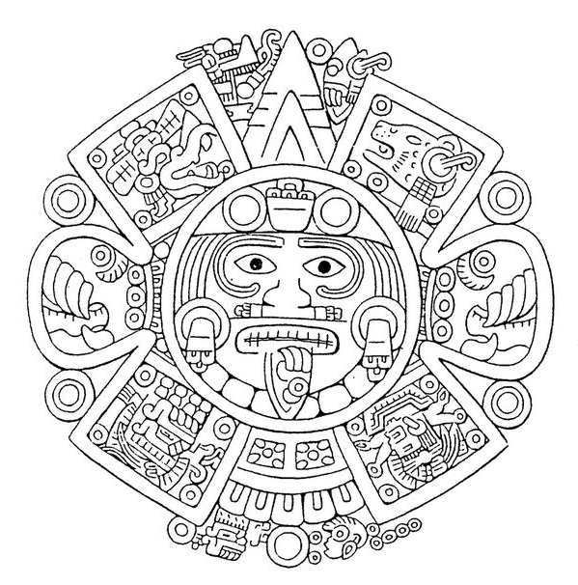
5th Sun is the only Sun that “moved”

Slide 18
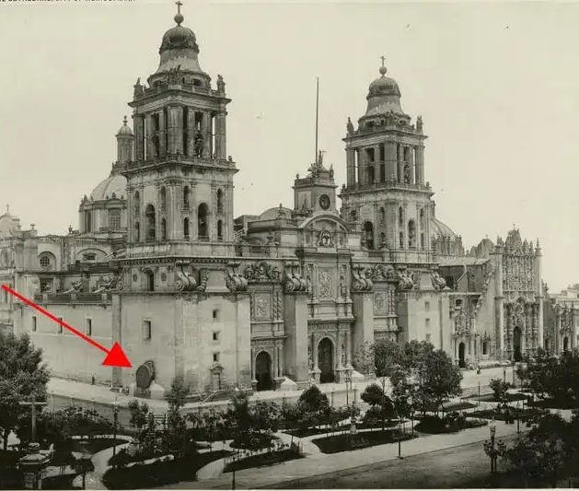
Catedral Piedra del sol, 1950s
Venustiano Carranza 1917

Slide 19
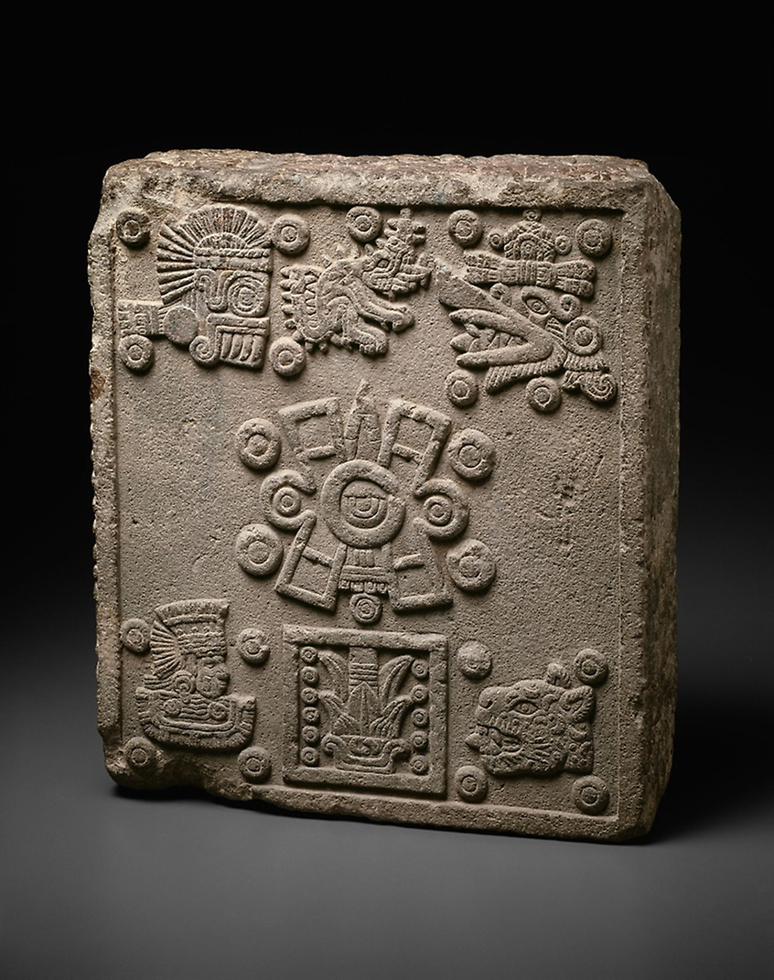
Coronation stone of Motecuhzoma II
July 15 1503
Counter clockwise from bottom right the date is
4 Jaguar,
4 Wind,
4 Rain,
4 Water,
4 Movement

Slide 20
The Year 13 Reed
At Teotihuacan, in the year 13 Reed, the gods gathered in the pre-dawn darkness. Two gods sacrificed themselves by throwing themselves on a sacrificial fire. They then rose into the sky as the Sun and the Moon.
In the upper part of this zone, a square carved between the tails of the serpents represents the date Matlactli Omey-Ácatl ("13-reed"). This is said to correspond to 1479, the year in which the Fifth Sun emerged in Teotihuacan during the reign of Axayácatl, and at the same time, indicating the year in which this monolithic sun stone was carved.

Slide 21
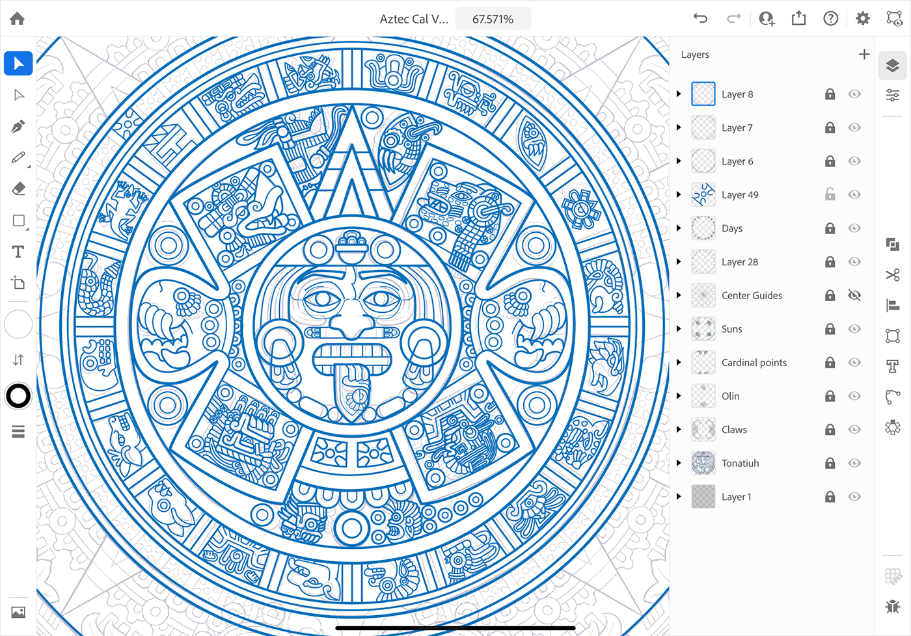
Tonatiuh
“He who goes forth shining”

Slide 22
Pedernal
flintstone knife of justice, the Fifth Sun

Slide 23
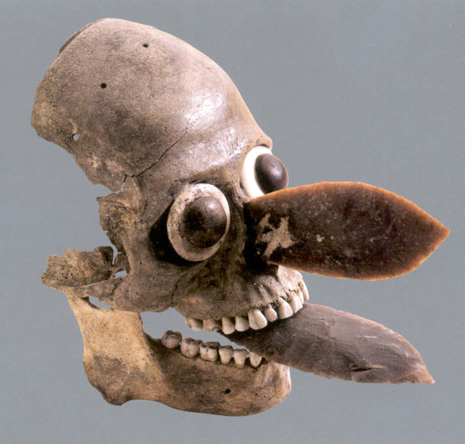
Pedernal
means flint-hearted

Slide 24
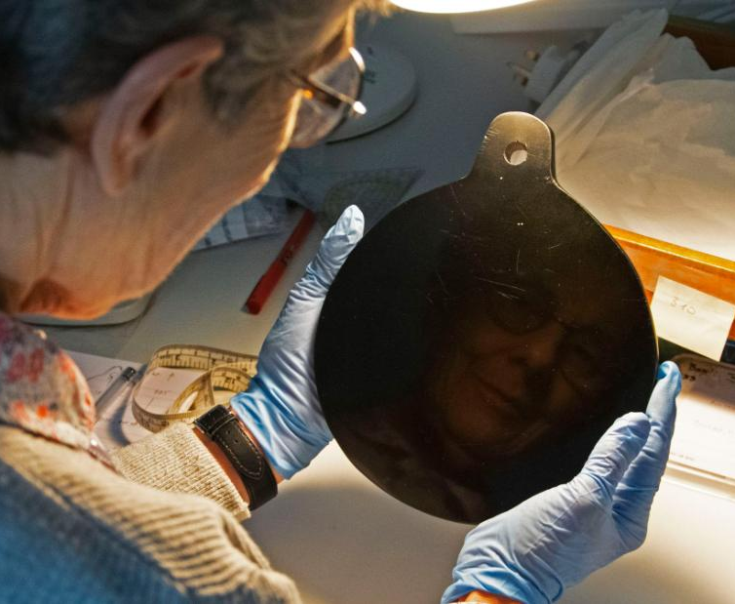
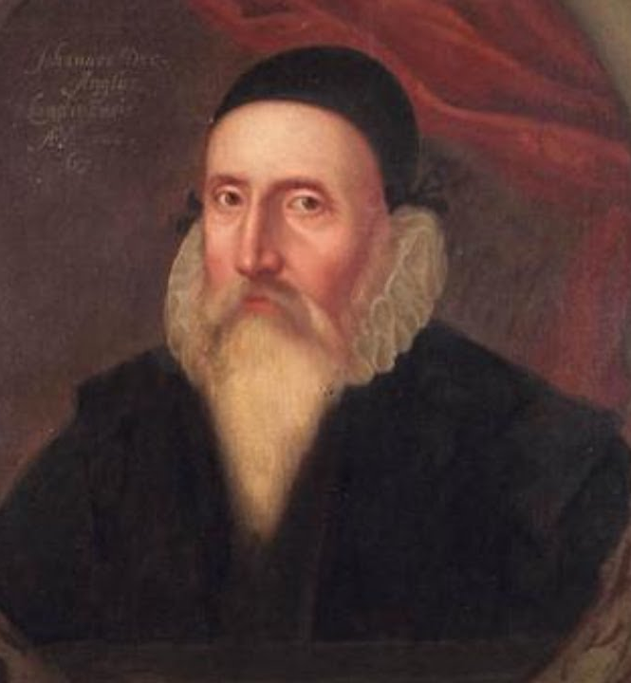
Euthanized by Spain
The Aztec empire fell on a summer afternoon in August 1521. Its conquerors were ruthless. Aztec priests were strangled, Aztec temples razed. The Spaniards faithfully broke every statue they could find. Aztec gold and silver they quickly melted down. A few Aztec objects have managed to survive in European state collections--Dr. John Dee of England, Queen Elizabeth's court astrologer, did his divinations on an Aztec "magic mirror"--but almost all late Aztec art was intentionally destroyed. The thought of all that melted gold, of all those shattered statues, intensifies the sense of lost, of needless pain, that haunts the present show.

Slide 25
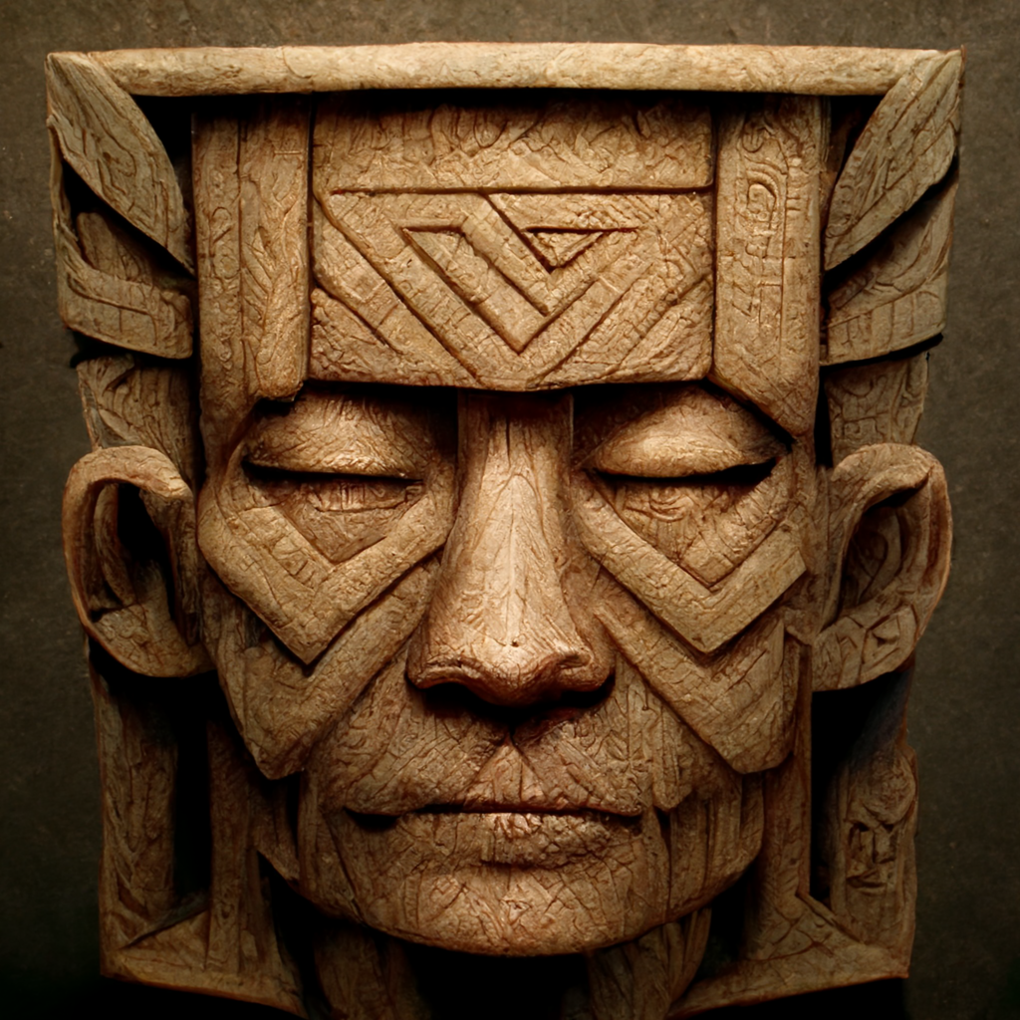
The Aztec calendar is divided into 'Suns', each lasting 6,625 years. The shift from the Fifth to the Sixth Sun started in July 1991 and will be complete in May 2021.
Sergio Maga

Slide 26
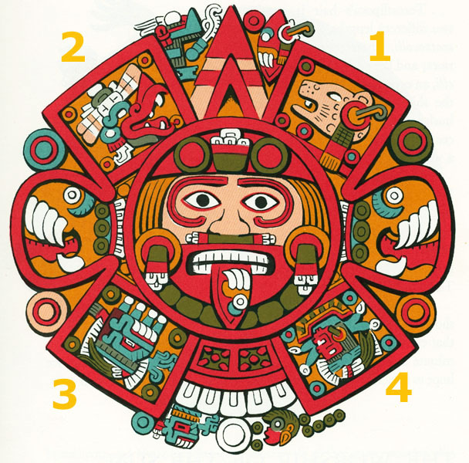

Slide 27
2
1
2nd Sun
Taurus
Monkey
Wind
1st Sun
Leo
Jaguar
Jaguar
5th Sun
(“4 Motion”)
is a new
1st Sun
Moon
3rd Sun
Aquarius
Turkey
Rain of Fire
4th Sun
Scorpio
Fish
Water
3
4

Slide 28
1st Sun
2nd Sun
4th Sun
3rd Sun

Slide 29
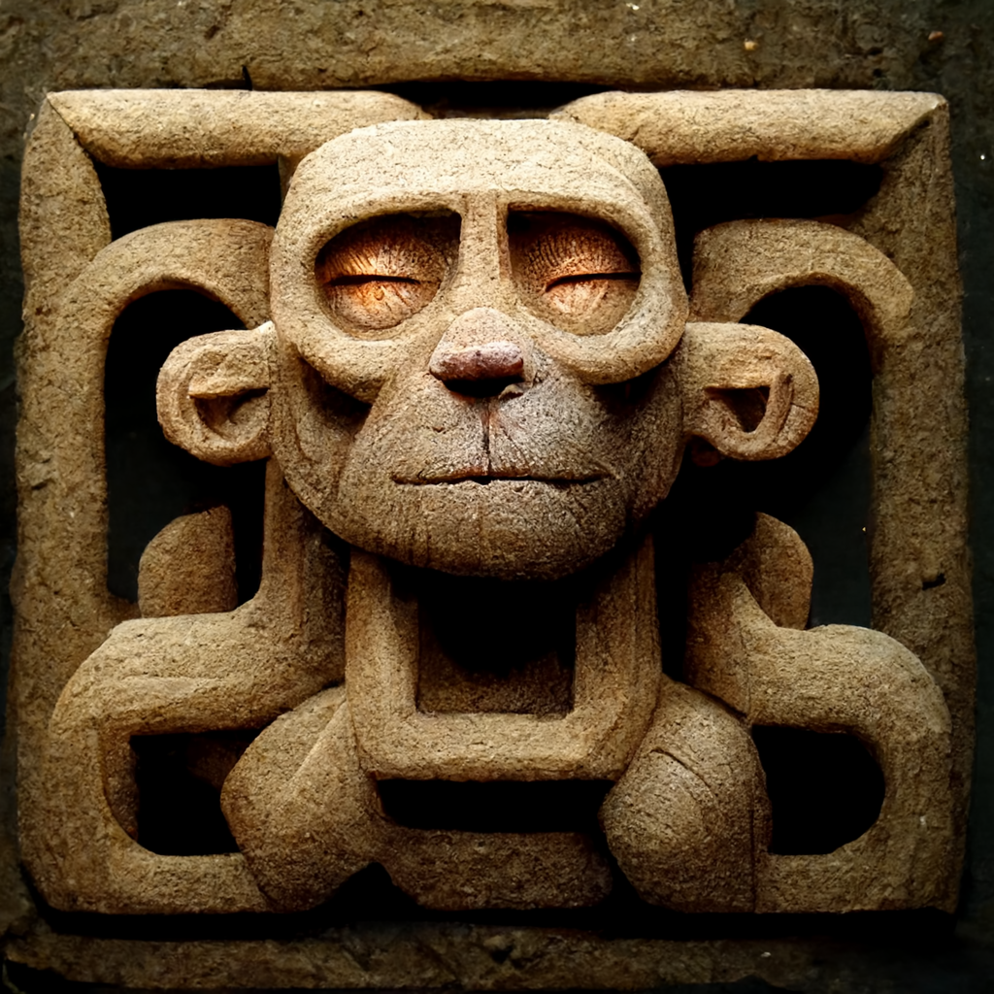
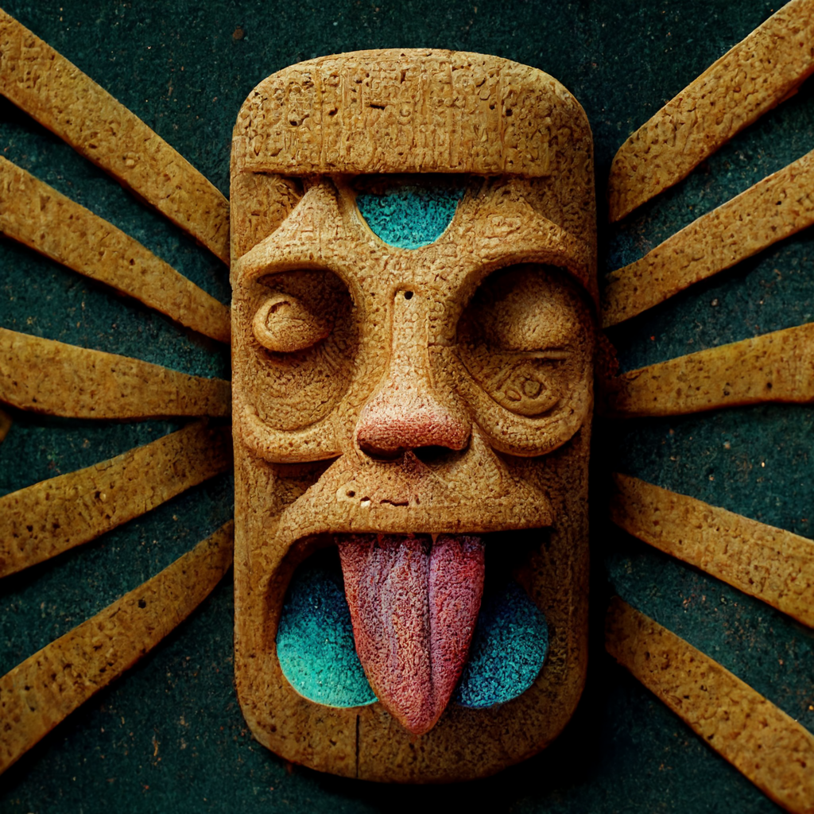
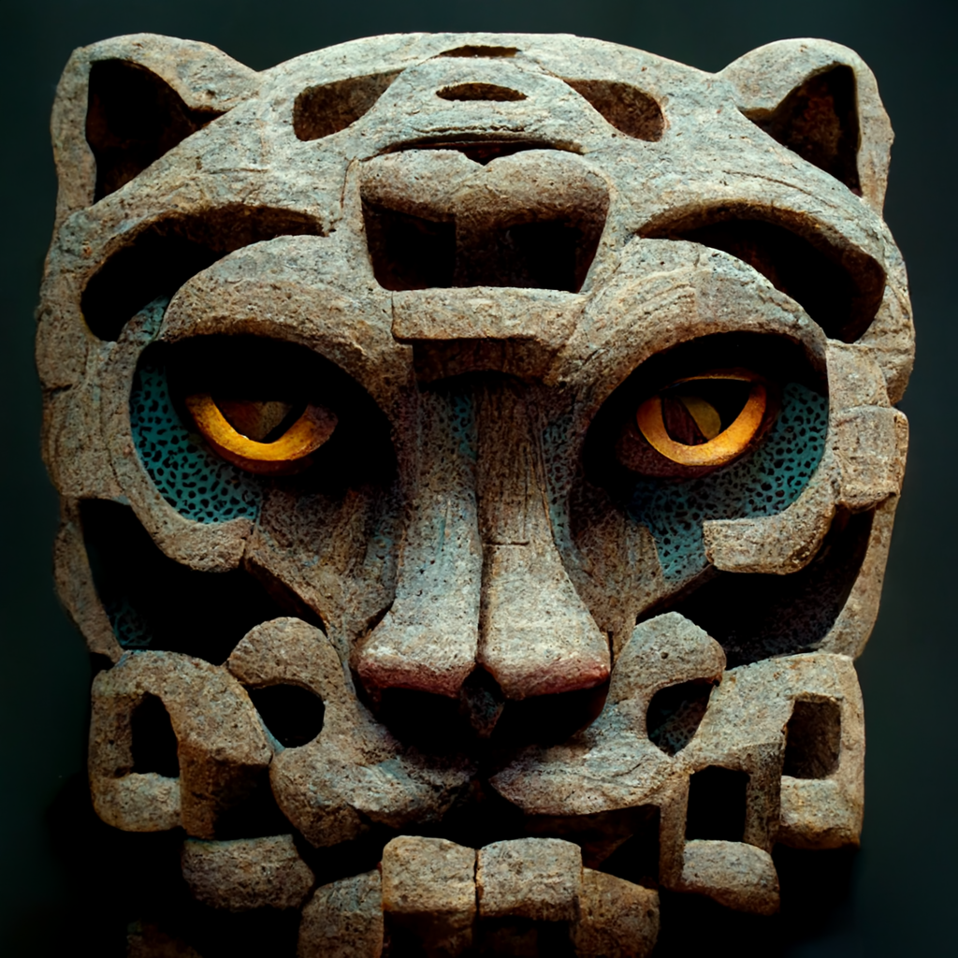
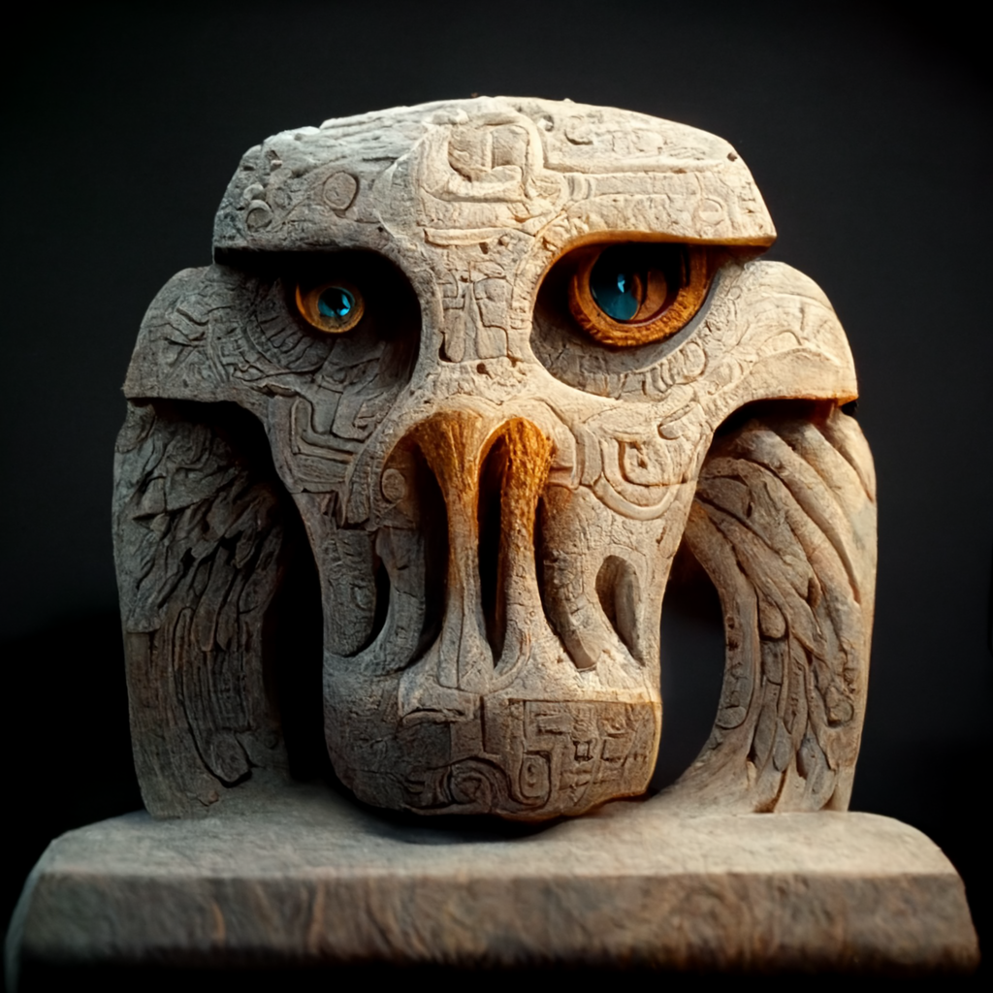
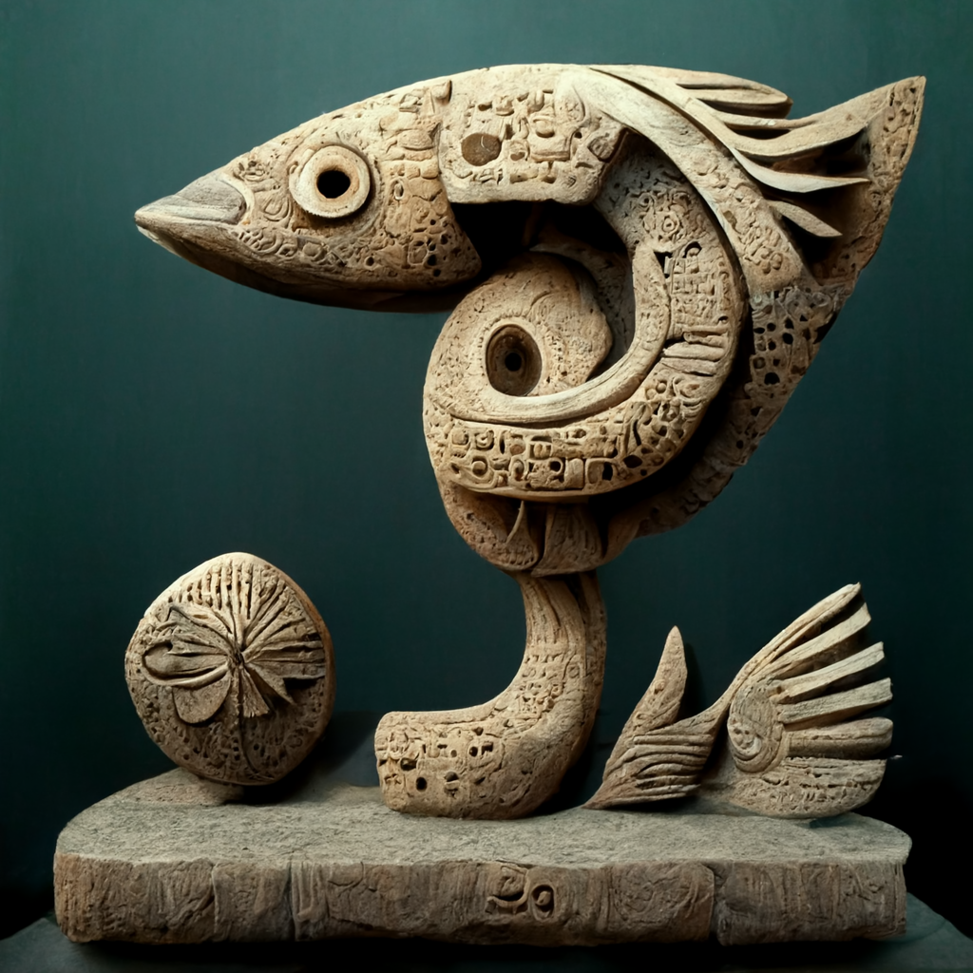
Wind Sun
Jaguar Sun
Fire Sun
Water Sun

Slide 30
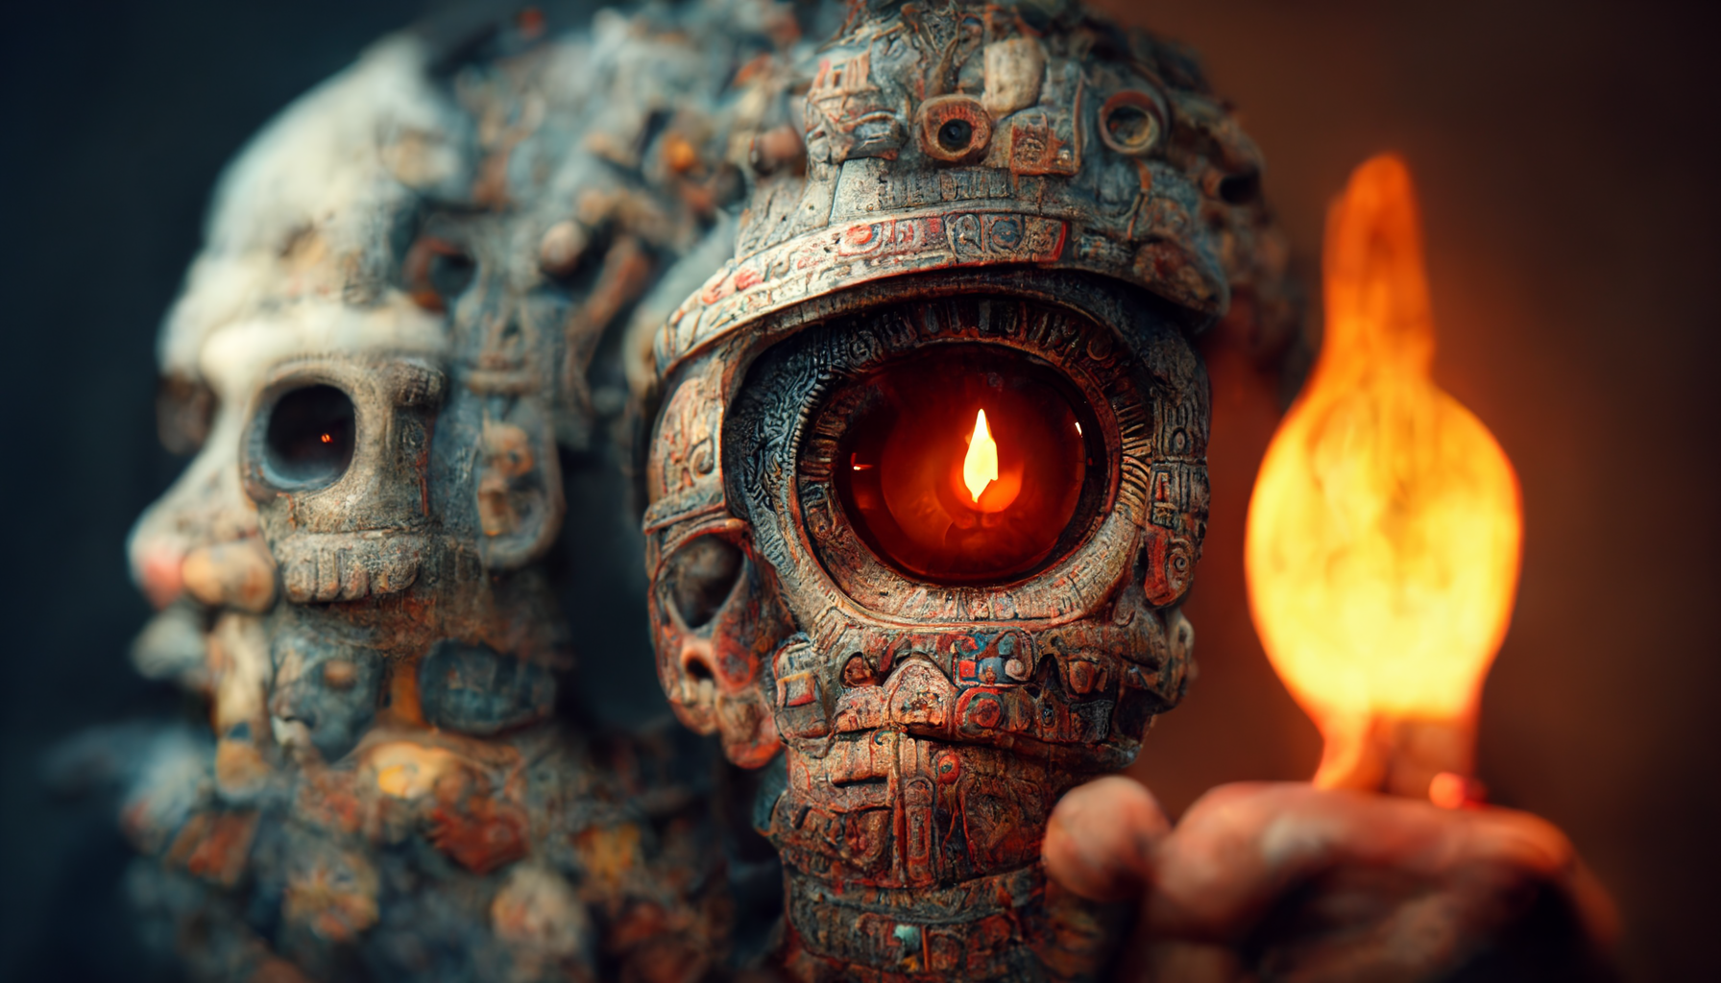
This first creation of the universe was done "together and without any time difference," when time was not yet counted, nor were the days, years, or ages.

Slide 31
1st Sun
Nahui-Ocelotl (Jaguar Sun)
Black Tezcatlipoca’s Sun
Sunset to midnight
Sun of Darkness
Half Sun
Nothing moved
Giants
Dishonest
Acorn eaters
Had to be watched to keep working
Jaguars devoured it
Sun too small
Notes:
With Ilancueye: the giants Xelhua, Tenoch, Ulmecatl, Xicalancatl, Mixtecatl, Otomitl

Slide 32
2nd Sun
Nahui-Ehécatl (Wind Sun)
Quetzalcoatl’s Sun
Midnight to Dawn
Monkeys/Apes
Pleasure
Wind/Hurricanes
Ate pinion nuts
Normal-sized people
Notes:
With Ilancueye: the giants Xelhua, Tenoch, Ulmecatl, Xicalancatl, Mixtecatl, Otomitl

Slide 33
3rd Sun
Nahui-Quiahuitl (Rain Sun)
Tlaloc’s Sun
Dawn to midday
Drought
Grief over loss of wife
Rain of fire
Turkeys/birds
Ate river reeds
Left world ashes
Notes:
With Ilancueye: the giants Xelhua, Tenoch, Ulmecatl, Xicalancatl, Mixtecatl, Otomitl

Slide 34
4th Sun
Nahui-Atl (Water Sun)
Chalchiuhtlicue’s Sun
Midday to dusk
Cried blood
Floods/rains
Fish/dogs
Ate wild seeds
Notes:
With Ilancueye: the giants Xelhua, Tenoch, Ulmecatl, Xicalancatl, Mixtecatl, Otomitl

Slide 35
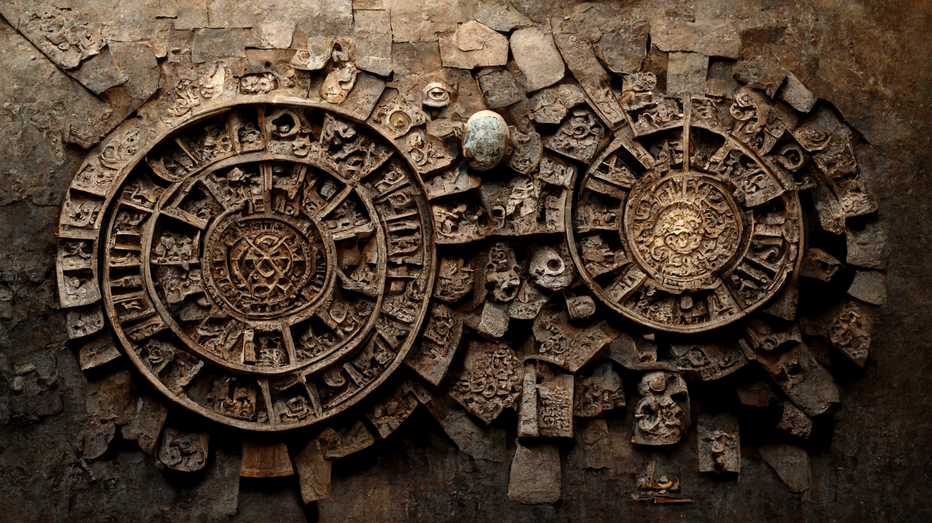
After six hundred years of inactivity, Quetzalcoatl and Huitzilopochtli began the creation of the world. They created fire and the sun, but not a whole sun, just a half sun that illuminated very little.

Slide 36
Notes:
With Ilancueye: the giants Xelhua, Tenoch, Ulmecatl, Xicalancatl, Mixtecatl, Otomitl Tlaltecuhtil

Slide 37
5th Sun
Nahui-Ollin (Earthquake Sun)
Tonatiuh’s Sun
Sunset to midnight
Earthquakes
First eclipse
First moon
Ate maize from ants in food mtn i.e. 1st Sun
Notes:
With Ilancueye: the giants Xelhua, Tenoch, Ulmecatl, Xicalancatl, Mixtecatl, Otomitl

Slide 38
The Fifth Sun
Nahui-Ollin (Earthquake Sun)
Sunset to midnight
Earthquakes
First eclipse
First moon
Ate maize from ants in food mtn
Underworld had bones Quetzalcoatl
At first there were no people under the fifth sun. The inhabitants of the earlier worlds had died, and their bones littered Mictlan, the underworld. Quetzalcoatl and his twin, Xolotl, journeyed to Mictlan to find the bones, arousing the fury of the Death Lord. As he fled from the underworld, Quetzalcoatl dropped the bones, and they broke into pieces. He gathered up the pieces and took them to the earth goddess Cihuacoatl (Snake Woman), who ground them into flour. Quetzalcoatl moistened the flour with his own blood, which gave it life. Then he and Xolotl shaped the mixture into human forms and taught the new creatures how to reproduce themselves.
Notes:
With Ilancueye: the giants Xelhua, Tenoch, Ulmecatl, Xicalancatl, Mixtecatl, Otomitl

Slide 39
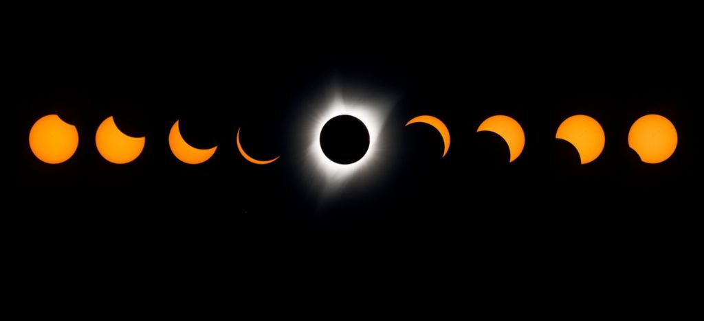
The beginning of this shift out of the Fifth Sun was marked by the full solar eclipse that was seen on July 11th, 1991, in Mexico City

Slide 40
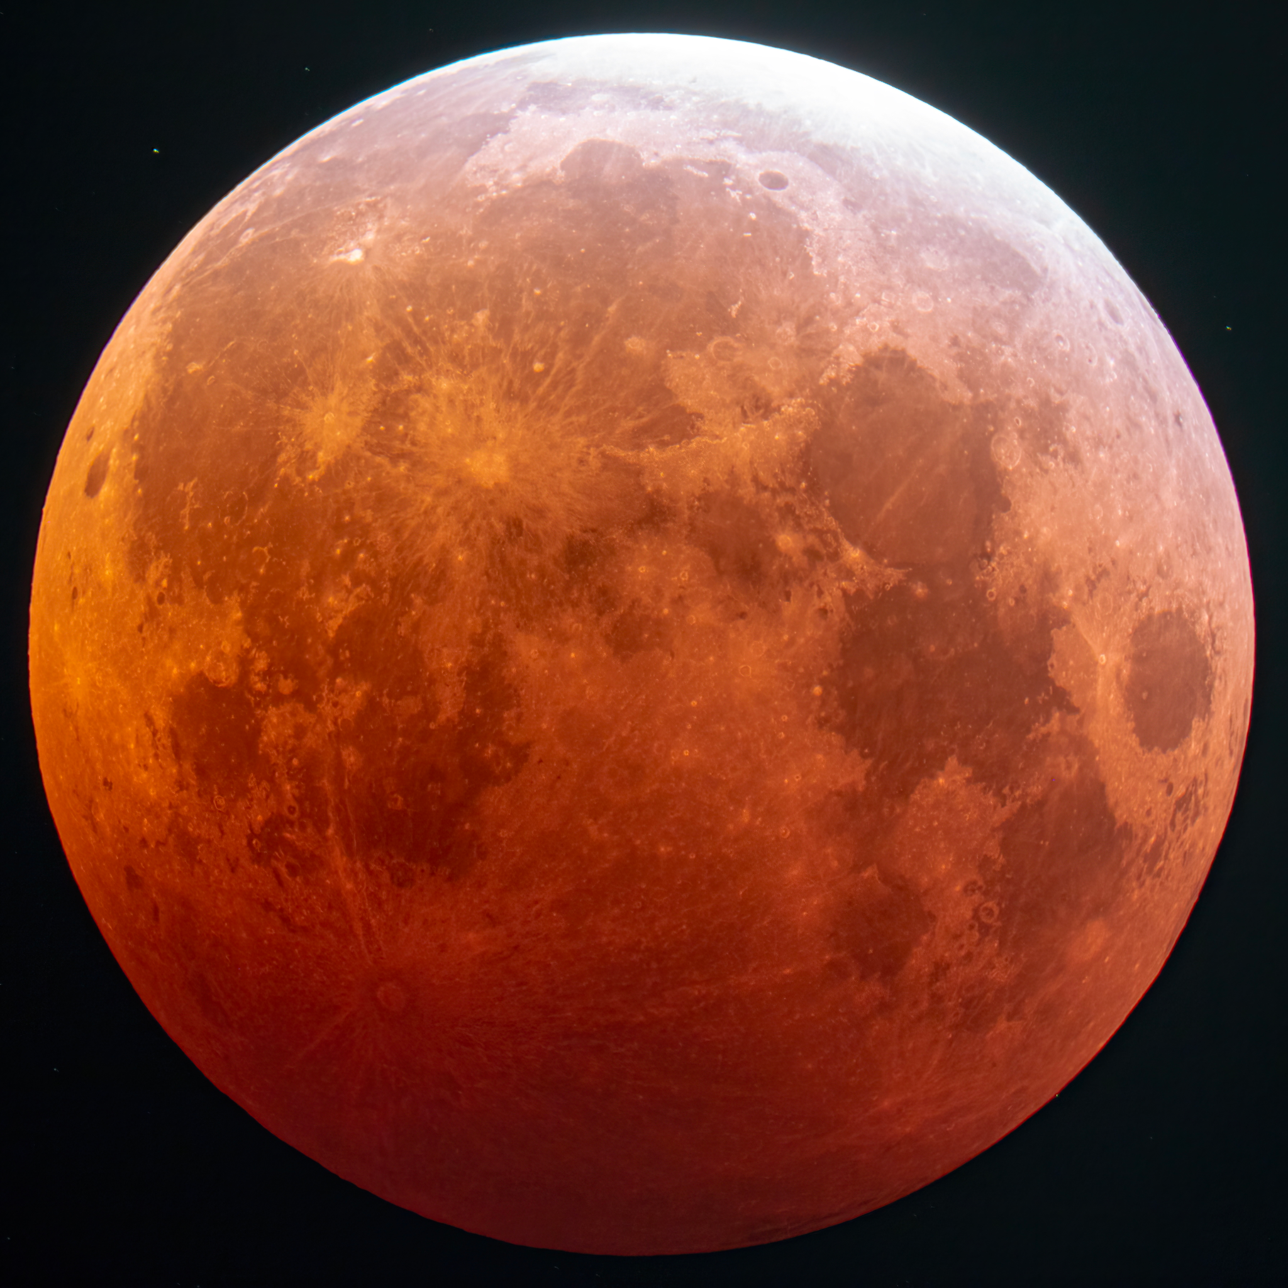
The First Eclipse was a product of the 5th Sun.

